Slide 1
Recipes De Beber
Group 4 - Drink Recipe App
Tomi Solaja, Ezeniel Rios, Sonu Patil, Izzi Salcedo, Zane Rush
Notes:
Recipes De Beber has a wide variety of drinks for everyone.

Slide 2
Introduction
The Drink Recipe App, allows users to select from a variety of refreshing beverage categories. Users can view descriptions and recipes of their selected beverages. There is also registration and login functionality available for restricted beverages and member features.
Allows users to select from a variety of refreshing beverage categories and view recipes
Users can register for additional content
Users can login to access additional content

Slide 3
Technologies
Frameworks
Flask
Selenium
Javalin
Cucumber
Postman
Psycopg2
TestNG
JUnit
Git
Languages
HTML
CSS
JavaScript
Python
Java
PostgreSQL
IDE’s
Pycharm
PgAdmin
VsCode
Intellij
Dbeaver
DevOps
GitHub
Trello

Slide 4
Table of Contents
1.Planning & Designing Website & Database (Tomi)
2.Testing Demos (Front-End & Back-End) (sonu & Izzi)
3.Functionality (Cocktails, age verification, Login and registration)

Slide 5
Demo
Showing off main page and site pages
Showing off tests for the Front-end and Back-End in both Java and Python
Showing off login and registration functionality and age restriction condition

Slide 6
Challenges
Retrieving information from Database
Implementing the age restriction feature
Folder Structure

Slide 7
Directions for Future development
Ability for users to leave reviews and ratings, and upload their own recipes
Additional food recipes
Recipe Generator

Slide 8
Conclusion

Slide 9
Planning & Designing Website & Database
Github Repo Made
Trello board created to track tasks and upcoming events (implemented sprints)
Database ERD generated from PgAdmin
Created User stories

Slide 10
Planning & Designing Website & Database
Application architecture was organized in both Java and Python
Models
Repositories
Services
Controllers
Utilities
Resources

Slide 11
Back End Testing
API Testing of operations (CRUD) done for both Python and Java
Demo for Unit Tests and Postman Testing

Slide 12
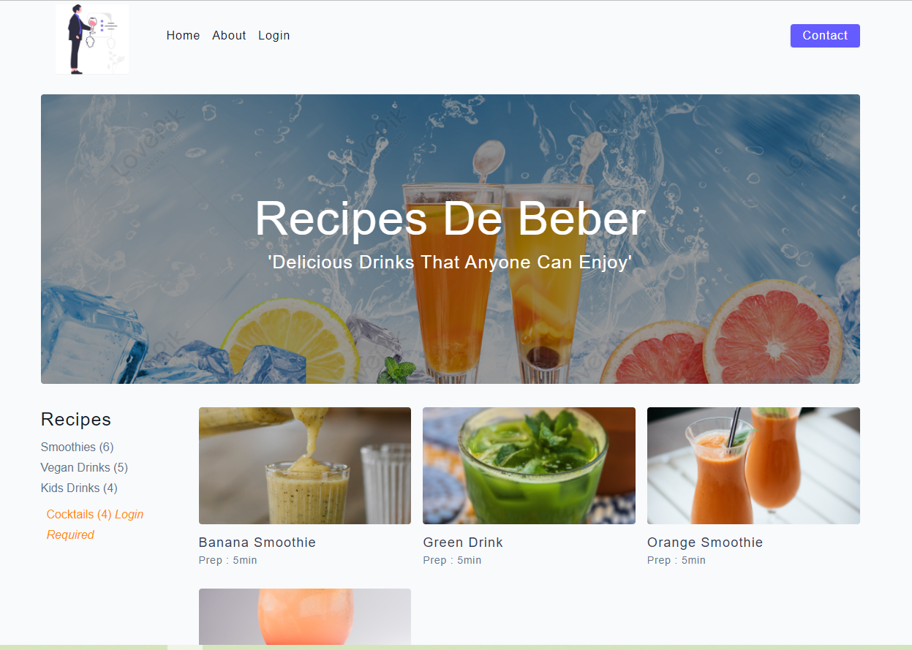
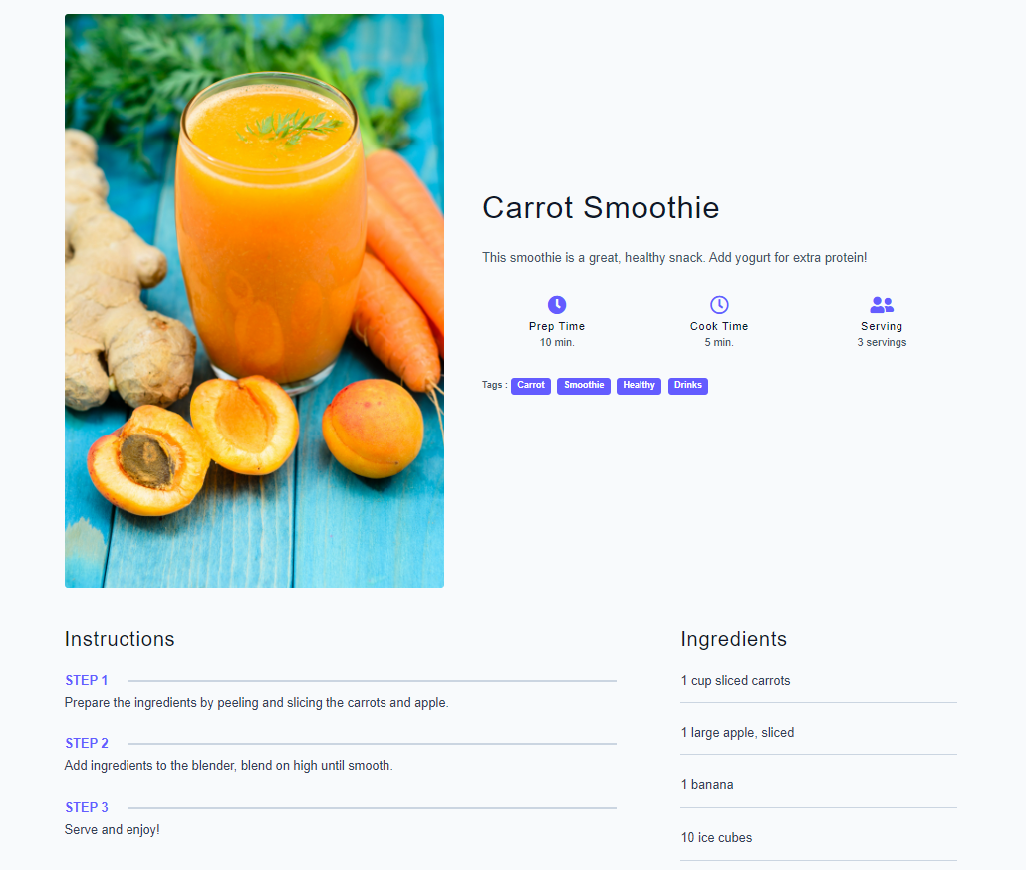
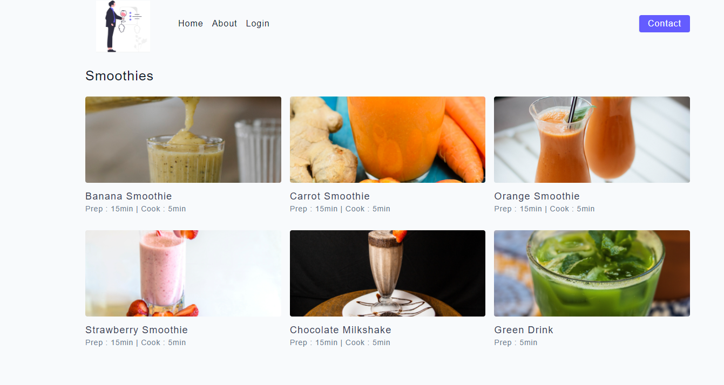
Front-End Website Design

Slide 13
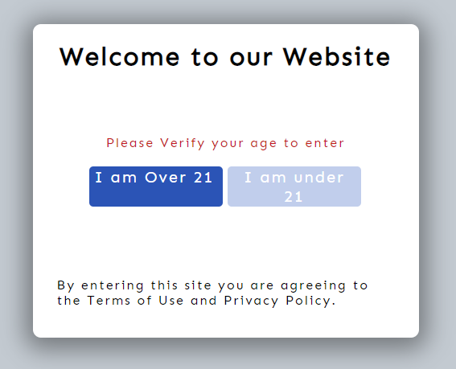
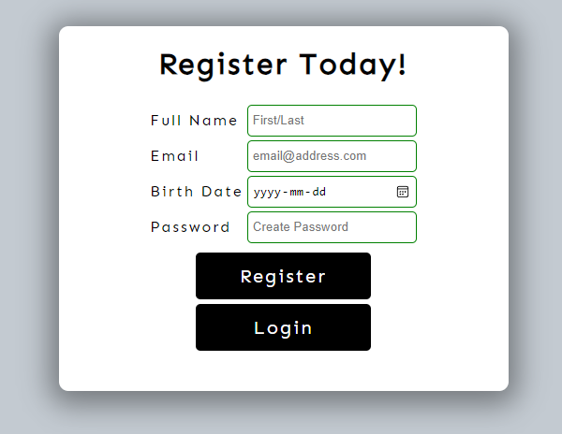
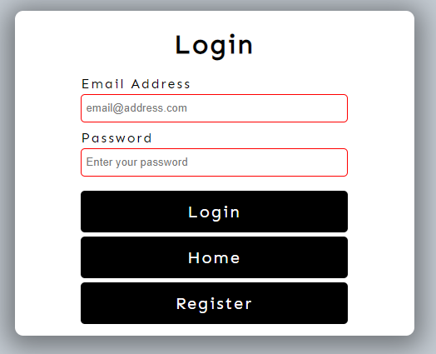
Login and Registration Functionality

Slide 14
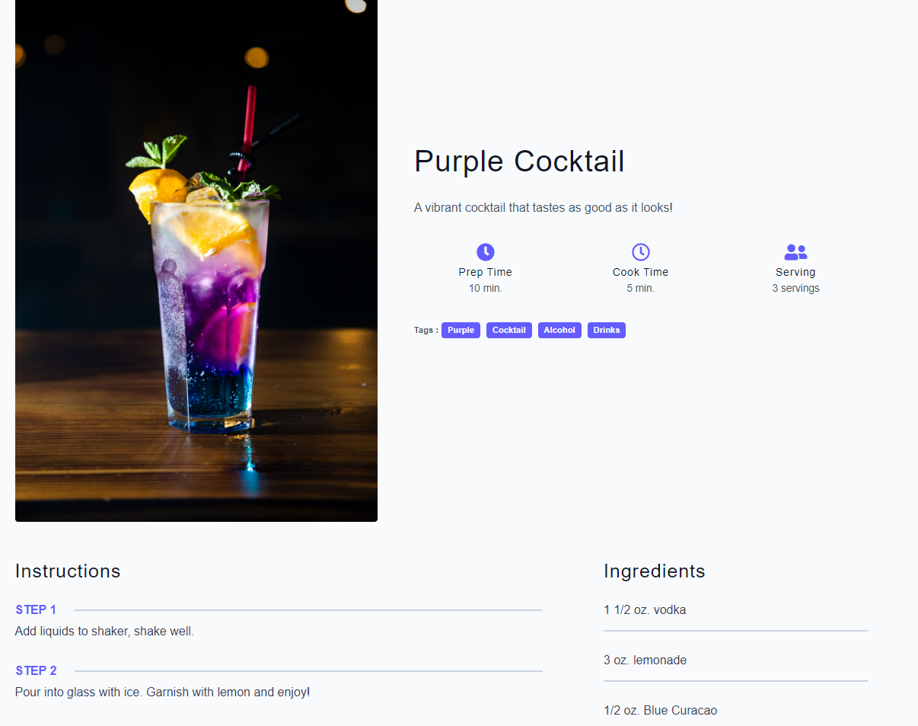
Cocktail Functionality

